Slide 1


Slide 2
Agenda
API & code
Reactive programming with flow
Collection Factories
Stream API new features
Private interface methods
HTTP/2 API
Stack walking
Environmental
Modular Java & Jlink
Jshell
Multi version jars
G1 made default

Slide 3
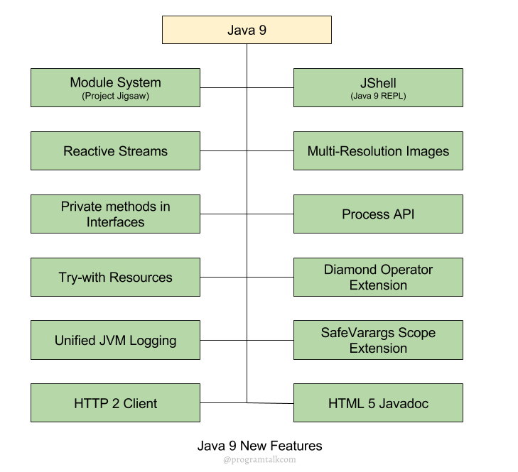

Slide 4
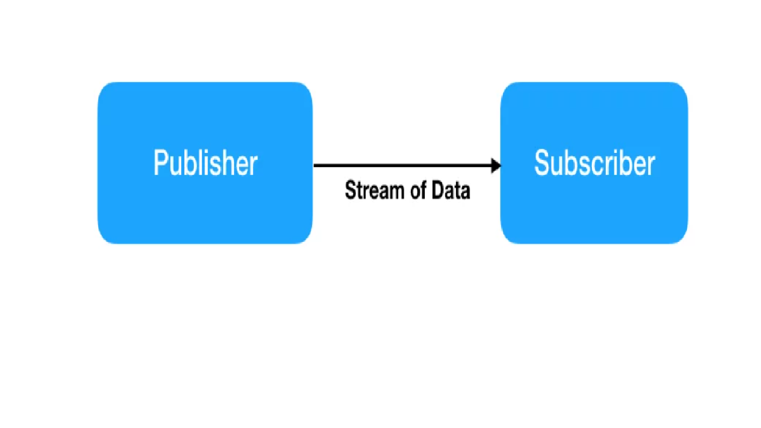
Java 9 Reactive Streams
Java 9 has introduced reactive streams support through java.util.concurrent.Flow API.
Reactive Streams is about asynchronous processing of stream, so there should be a Publisher and a Subscriber.
The Publisher publishes the stream of data and the Subscriber consumes the data.
Processor is the entity sitting between the end publisher and subscriber to transform the data received from publisher so that subscriber can understand it. We can have a chain of processors.

Slide 5
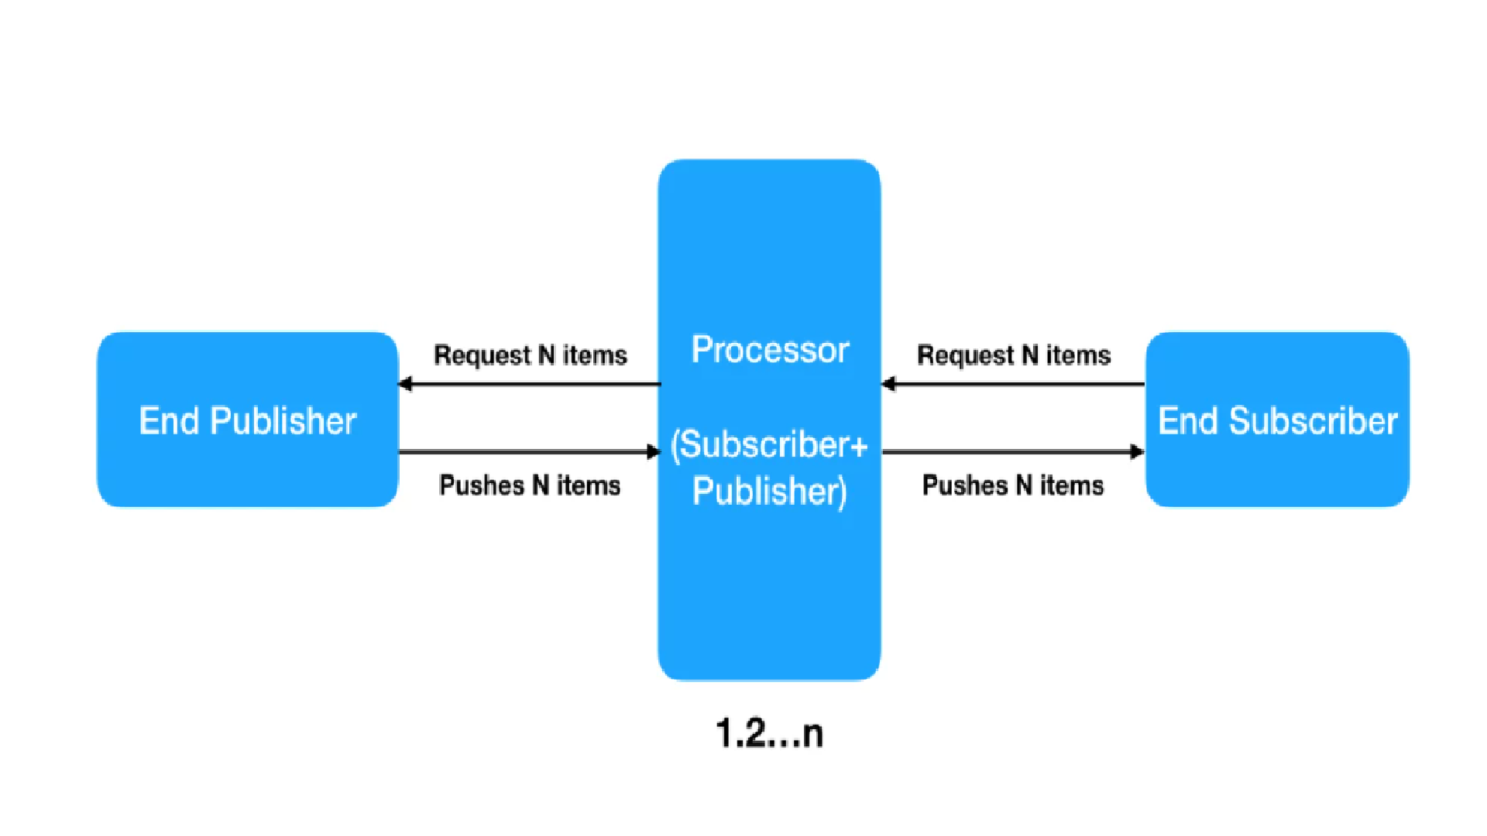

Slide 6
Introduction to Java 9’s Flow API
Flow API, which enables us to adopt Reactive Programming using just the JDK, not needing additional libraries such as RxJava or Project Reactor, amongst others.
The interface Flow.Publisher<T> defines methods to produce items and control signals.
The interface Flow.Subscriber<T> defines methods to receive those messages and signals.
The interface Flow.Subscription defines the methods to link both the Publisher and the Subscriber.
The interface Flow.Processor<T,R> defines methods to do some advanced operations like chaining transformations of items from publishers to subscribers.
Finally, the class SubmissionPublisher<T>implements Flow.Publisher<T> and it's a flexible producer of items, compliant with the Reactive Streams initiative.

Slide 7
Java 9 Flow API
Java 9 Flow API implements the Reactive Streams Specification.
Flow API is a combination of Iterator and Observer pattern.
Iterator works on pull model where application pulls items from the source.
Observer works on push model and reacts when item is pushed from source to application.
Java 9 Flow API subscriber can request for N items while subscribing to the publisher.
Then the items are pushed from publisher to subscriber until there are no more items left to push or some error occurs.

Slide 8
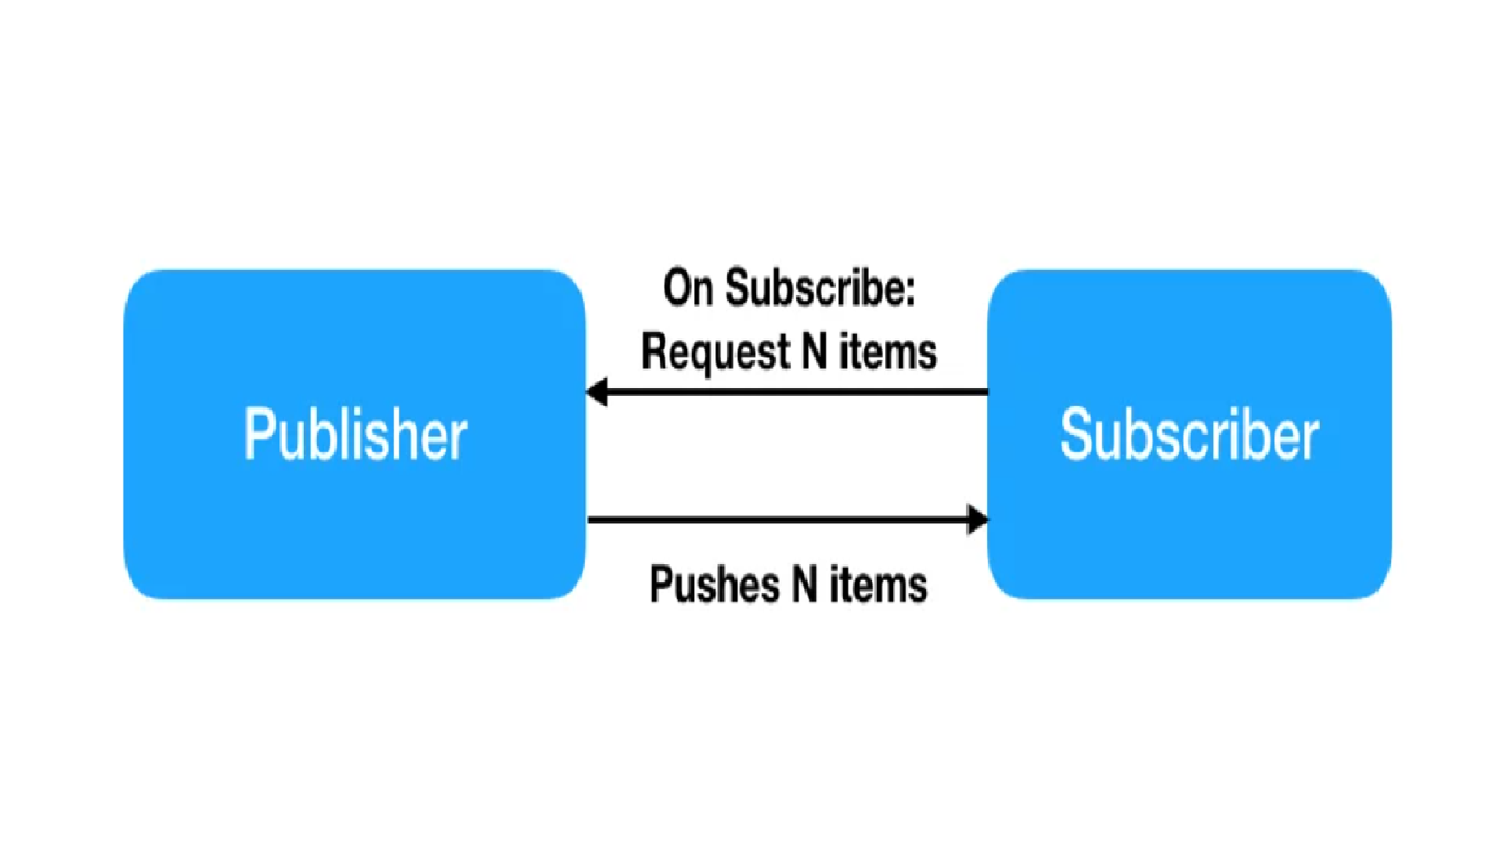

Slide 9
Java 9 Flow API Classes and Interfaces
java.util.concurrent.Flow: This is the main class of Flow API. This class encapsulates all the important interfaces of the Flow API. This is a final class and we can’t extend it.
java.util.concurrent.Flow.Publisher: This is a functional interface and every publisher has to implement it’s subscribe method to add the given subscriber to receive messages.
java.util.concurrent.Flow.Subscriber: Every subscriber has to implement this interface. The methods in the subscriber are invoked in strict sequential order. There are four methods in this interface:
onSubscribe: This is the first method to get invoked when subscriber is subscribed to receive messages by publisher. Usually we invoke subscription.request to start receiving items from processor.
onNext: This method gets invoked when an item is received from publisher, this is where we implement our business logic to process the stream and then request for more data from publisher.
onError: This method is invoked when an irrecoverable error occurs, we can do cleanup taks in this method, such as closing database connection.
onComplete: This is like finally method and gets invoked when no other items are being produced by publisher and publisher is closed. We can use it to send notification of successful processing of stream.
java.util.concurrent.Flow.Subscription: This is used to create asynchronous non-blocking link between publisher and subscriber. Subscriber invokes its request method to demand items from publisher. It also has cancel method to cancel the subscription i.e. closing the link between publisher and subscriber.
java.util.concurrent.Flow.Processor: This interface extends both Publisher and Subscriber, this is used to transform the message between publisher and subscriber.
java.util.concurrent.SubmissionPublisher: A Publisher implementation that asynchronously issues submitted items to current subscribers until it is closed. It uses Executor framework We will use this class in reactive stream examples to add subscriber and then submit items to them.

Slide 10
How to implement reactive streams using Flow API in Java 9?
Flow API is official support for reactive streams specification since Java 9. It is a combination of both Iterator and Observer patterns. The Flow API is an interoperation specification and not an end-user API like RxJava.
Flow API consists of four basic interfaces:
Subscriber: The Subscriber subscribes to Publisher for callbacks.
Publisher: The Publisher publishes the stream of data items to the registered subscribers.
Subscription: The link between publisher and subscriber.
Processor: The processor sits between Publisher and Subscriber, and transforms one stream to another.

Slide 11
Java 9 - Collection Factory Methods
Oracle Corp has introduced some convenient factory methods to create Immutable List, Set, Map and Map.Entry objects.
These utility methods are used to create empty or non-empty Collection objects.
With Java 9, new factory methods are added to List, Set and Map interfaces to create immutable instances.
These factory methods are convenience factory methods to create a collection in less verbose and in concise way.

Slide 12
Java 9 – Stream API Enhancements
ava 9 introduced four new methods for Stream API.
These methods are added in java.util.Stream interface.
Java 9 added the following four methods to the Stream.
1. dropWhile() – default method 2. takeWhile() – default method 3. iterate() – static method 4. ofNullable() – static method

Slide 13
Private Methods in Java 9 Interfaces
Java 8 Interface Changes
Some new features to interface were introduced in Java 8 i.e. Default methods and Static methods feature. In Java 8, an interface can have only four types:
Constant variables
Abstract methods
Default methods
Static methods

Slide 14
Java 9 Interface Changes
Java 9 introduced private methods and private static method in interfaces. In Java 9 and later versions, an interface can have six different things:
Constant variables
Abstract methods
Default methods
Static methods
Private methods
Private Static methods
These private methods will improve code re-usability inside interfaces and will provide choice to expose only our intended methods implementations to users.These methods are only accessible within that interface only and cannot be accessed or inherited from an interface to another interface or class.

Slide 15
HTTP/2 Client feature of Java 9
HTTP/2 client is one of the feature of JDK 9. HTTP/2 is the newest version of the HTTP Protocol.
By the help of HTTP/2 client, from the Java application, we can send the HTTP request and we can process the HTTP response.
Before JDK 9, To send HTTP request and to process the HTTP response we are using HttpURLConnection class.
Now you will wonder why HTTP/2 client is introduced in JDK 9 when we have HttpURLConnection to solve the purpose.
But the existing HttpURLConnection has few problems that are eliminated in HTTP/2 client.

Slide 16
Latency Optimization Techniques for HTTP/1.1
HTTP/1.1 has needed (sometimes heavy) workarounds to meet today’s requirements.
As one HTTP connection can download one resource at a time, browsers fetch them concurrently in order to be able to render the page faster. However, the number of parallel connections per domain is limited, and domain sharding was used to work that around.
A similar optimization technique was to combine multiple resources (CSS, JavaScript) into a single bundle in order to be able to get them with a single request.
The trade-off is sparing a network round-trip with the risk of not using some parts of the assembled resource bundle at all. In some cases, complicated server-side logic takes care of selecting the pertinent static resources and merging them for a particular page request.
Image sprites are a technique similar to bundling CSS and JavaScript files for lowering the number of requests.
Another technique is inlining static resources to the HTML.

Slide 17
Advantages of HTTP/2
In HTTP/1.1, we cannot have more than six connections open at a time, so every request has to wait for the others to complete.To avoid this, developers are used to doing workaround as a best practice. Those best practices include minifying, compressing, and zipping the files together, sprite images, etc. This can be eliminated by multiplexing in HTTP /2. This means that HTTP/2 can send multiple requests for data in parallel over a single TCP connection.
In HTTP/1.1, every request sent to the server will have the header's additional data, which increases bandwidth.This can be eliminated in HTTP/2.0 by having headers packed into one compressed block that will be sent as a unit and, once transmission is finished, the header blocks are decoded. It uses HPack for header compression.
In an HTTP/1.1 environment, an HTML page is sent to the browser. The browser has to parse it and decide which assets are required, then request those assets from the server. This can be eliminated by Server Push in HTTP/2. It allows servers to push responses proactively to the client instead of waiting for the new request to process.
Text is replaced by Binary in HTTP/2.0
Domain sharding and asset concatenation are no longer needed with HTTP/2.

Slide 18
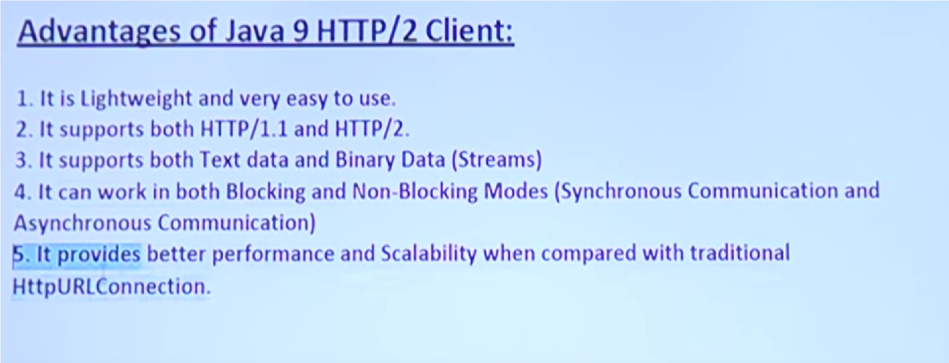

Slide 19
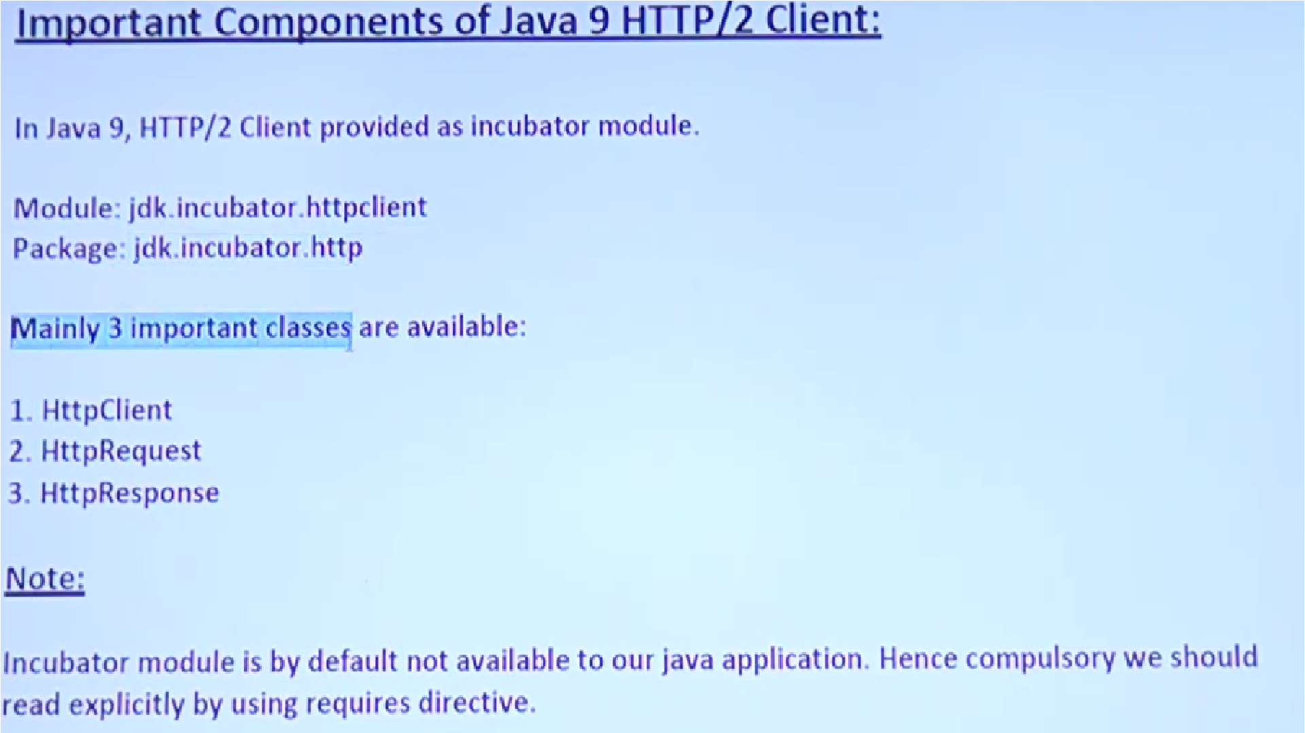

Slide 20
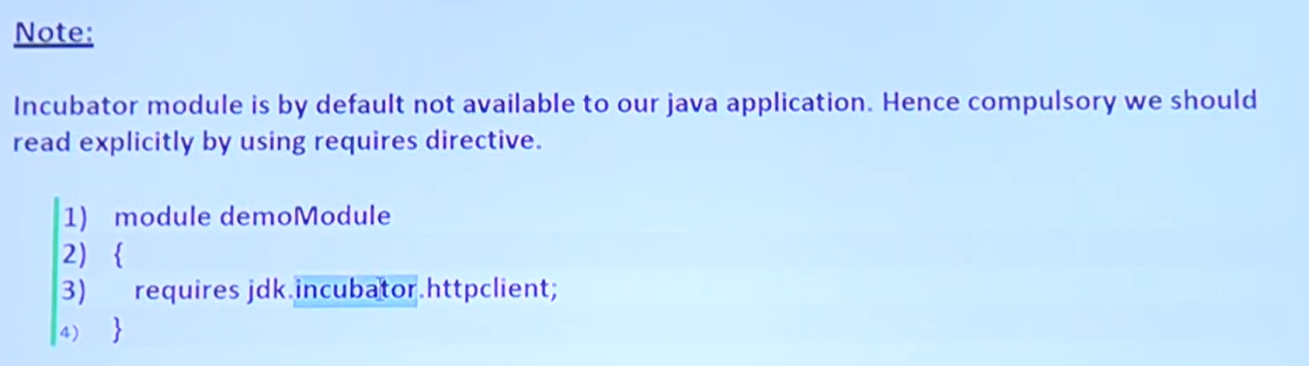

Slide 21
Drawbacks of HTTP/2.0
Many of us expected more features in the HTTP 2.0 protocol, but many were not included in the final version to support the backward compatibility.
It is not super fast.
It is vulnerable to attacks. (BREACH and CRIME).
HTTP/2.0 decided to leave the encryption as it is in HTTP/1.1.
HTTP/2.0 isn't very careful about cookie security.

Slide 22
JLink | Java Linker
n a single sentence, we can say that Jlink is used to create our own customized small JRE(Java RunTime Environment).
JLink is the Java’s new command line tool(available in JDK_HOME/bin) which allows us to link sets of only required modules (and their dependencies) to create runtime environment (our own JRE). Usually, we use the default JRE for running our programs which are provided by the Oracle Corporation, but if we want our own JRE like geeks jre then we can go for JLINK.

Slide 23
Modular Java
Modularity adds a higher level of aggregation above packages. The key new language element is the module—a uniquely named, reusable group of related packages, as well as resources (such as images and XML files) and a module descriptor specifying
the module’s name
the module’s dependencies (that is, other modules this module depends on)
the packages it explicitly makes available to other modules (all other packages in the module are implicitly unavailable to other modules)
the services it offers
the services it consumes
to what other modules it allows reflection

Slide 24
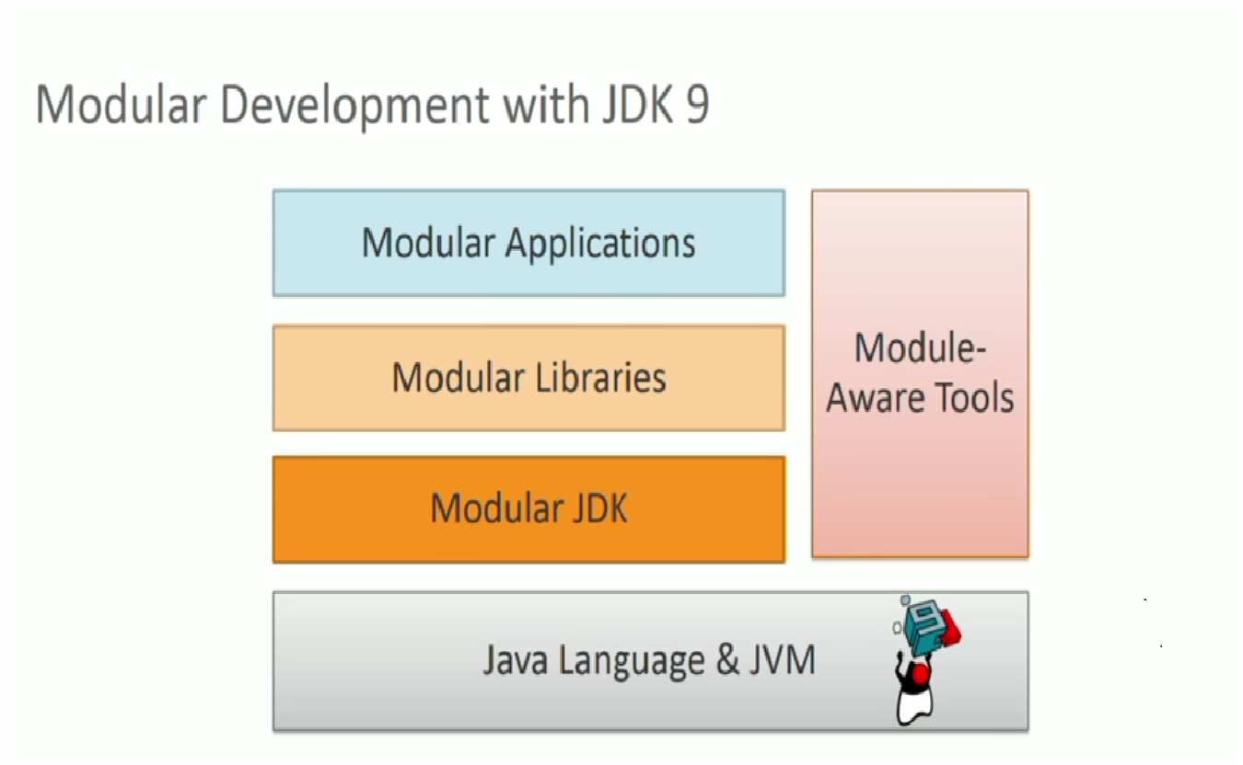

Slide 25
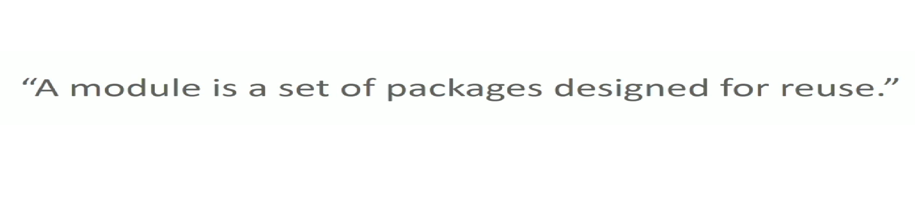


Slide 26
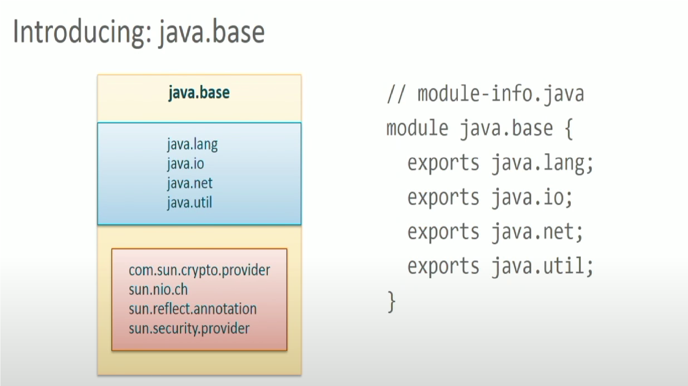

Slide 27
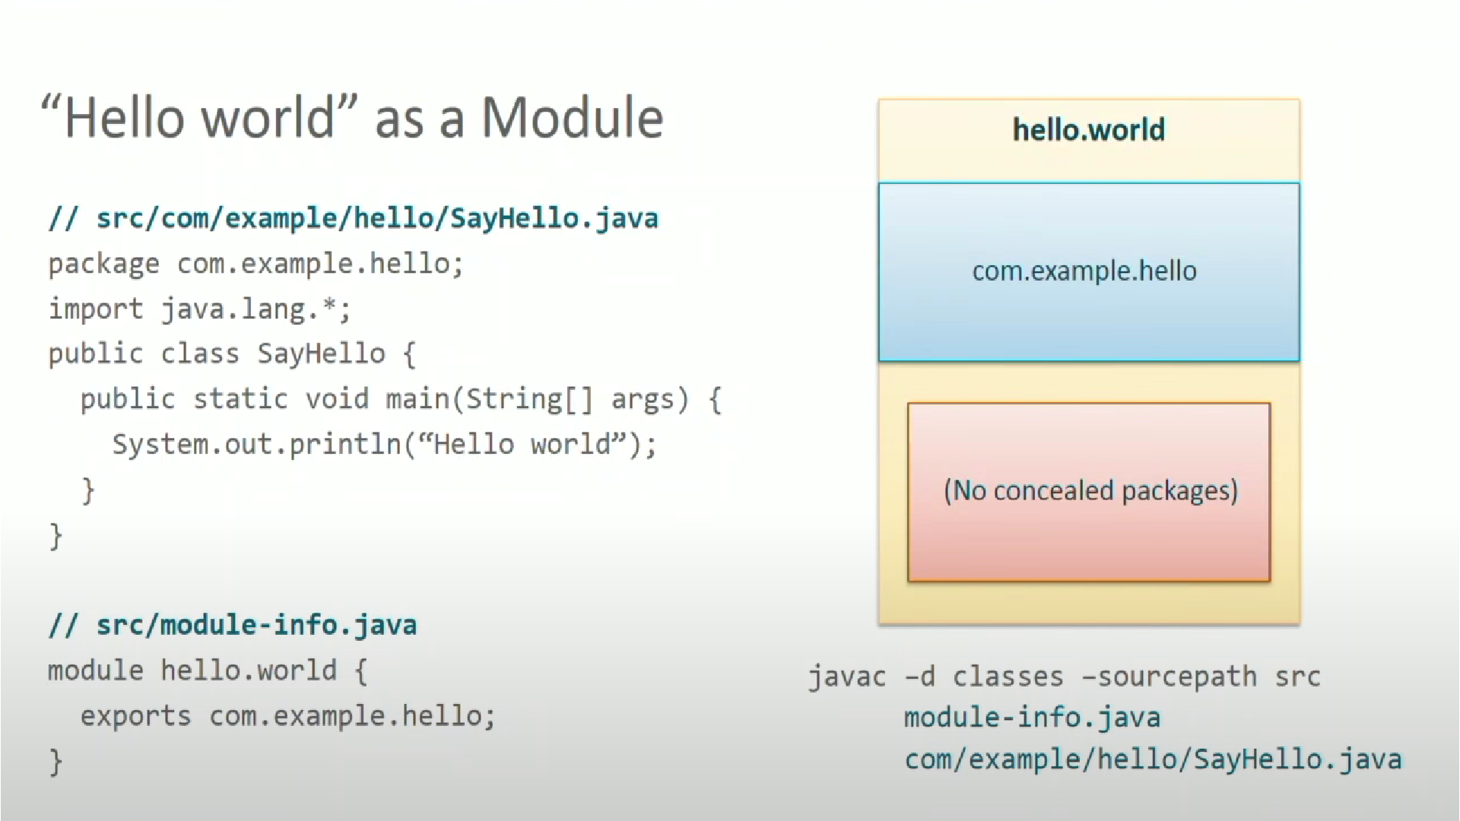

Slide 28
JShell (Java 9 New Feature)
The Java Shell tool (JShell) is an interactive tool for learning the Java programming language and prototyping Java code.
JShell is a Read-Evaluate-Print Loop (REPL), which evaluates declarations, statements, and expressions as they are entered and immediately shows the results.
The tool is run from the command line. JShell was introduced in java 9 and hence can not be used in java 8.

Slide 29
JLink is a new linker tool that has been used to create our own customized JRE.
Usually, we can run our program using default JRE provided by Oracle. If we need to create our own JRE then use this tool.
JLink tool can help to create its own JRE with only the required class to run the application.
It can reduce the size of the API developed and the dependency of using full JRE.
In Java 9, we have a new phase between compiling the code and its execution link time.
Link time is an optional phase between the phases of compile-time and runtime.

Slide 30
Command to create custom JRE
jlink --module-path --add-modules --limit-modules –output
module-path is the path where observable modules have discovered by the linker. It can be modular JAR files, JMOD files, and modules.
add-modules names the modules to add to the run-time image, these modules can, via transitive dependencies, cause additional modules to be added.
limit-modules limits the universe of observable modules.
the output is the directory that contains the resulting run-time image.
jlink --module-path $JAVA_HOME/jmods:mlib --add-modules com.greetings --output greetingsapp
In the above command, the value to module-path is a PATH of directories containing the packaged modules. JAVA_HOME/jmods is a directory containing java.base.jmod, other standards, and JDK modules. The directory mlib on the module path containing the artifact for module com.greetings.

Slide 31
Multi-Release Jar Files
Multi-version compatible JAR function allows us to create the version of a class that we choose to use only when running library programs in a specific version of the Java environment.
We can specify the compiled version through the "--release" parameter.

